Slide 1
Employee Data Analysis using Excel
STUDENT NAME: ISHWARYA A
REGISTER NO: 2213211036040
DEPARTMENT: COMMERCE
COLLEGE: PRESIDENCY COLLEGE CHENNAI-600005

Slide 2
PROJECT TITLE
Employee salary Analysis using Excel

Slide 3


AGENDA
Problem Statement
Project Overview
End Users
Our Solution and Proposition
Dataset Description
Modelling Approach
Results and Discussion
Conclusion
3/21/2024 Annual Review

Slide 4

PROBLEM STATEMENT
The objective of this analysis is to assess the current salary distribution across various departments, genders, and work locations within the company. This evaluation will help identify any disparities or inconsistencies in compensation, ensure fair and competitive salaries, and guide future salary adjustments to align with company growth and Market standards

Slide 5

PROJECT OVERVIEW
Objectives:
Analyze salary distribution across departments, genders, and locations. Identify disparities and inconsistencies in compensation. Ensure competitive and fair salaries to support

Slide 6

Who are the end users?
The end users of the employee salary analysis are:
HR Department: For evaluating and adjusting compensation.
Senior Management: For strategic decision-making on salaries.
Finance Department: For financial planning and budgeting.
Department Managers: For ensuring fair compensation within teams.

Slide 7


Our solution and it’s value proportion :
Our Solution: A comprehensive employee salary analysis that identifies disparities, ensures fair compensation, and aligns salaries with market standards.
Value Proposition:
Fairness: Promotes equity across the organization.
Competitiveness: Aligns salaries with industry benchmarks. . Retention: Supports employee satisfaction and retention. . Strategic Decision-Making: data-driven management and HR decisions.

Slide 8
Dataset description:
Emp ID: Unique identifier for each employee.
Name: Employee's full name.
Gender: Gender of the employee.
Department: Department where the employee works.
Salary: Annual salary of the employee.
Start Date: Date the employee joined the company.
FTE: Full-Time Equivalent status indicating if the employee is full-time or part-time. Employee Type: Nature of employment (e.g., Permanent, Fixed Term).
Work Location: The geographical location where the employee works (e.g., Remote, Seattle, Hyderabad).

Slide 9

THE ‘WOW’ IN OUR SOLUTION
Actionable Insights: Uncover hidden salary disparities and provide clear recommendations for improvement.
Customized Analysis: Tailored to your company's unique structure, ensuring relevance and accuracy.
Proactive Planning: Empowers management to make forward-thinking decisions that boost employee morale and retention.
Efficiency Gains: Streamlines the salary review process, saving time and resources.

Slide 10
MODELLING
Data Cleaning & Preprocessing: Standardize formats (e.g., dates, salaries).Handle missing values and outliers to ensure data quality.
Exploratory Data Analysis (EDA):Visualize salary distribution across departments, genders, and locations. Identify trends, anomalies, and disparities.
Segmentation: Group employees based on factors like department, role, and experience to understand salary patterns.
3/21/2024 Annual Review
10

Slide 11

Predictive Modeling: Use regression models to predict fair salary ranges based on factors like experience, role, and market data.
Scenario Analysis:Simulate the impact of salary adjustments on budget and employee satisfaction.
Reporting & Visualization: Generate dashboards and reports to communicate findings to stakeholders effectively.
11

Slide 12
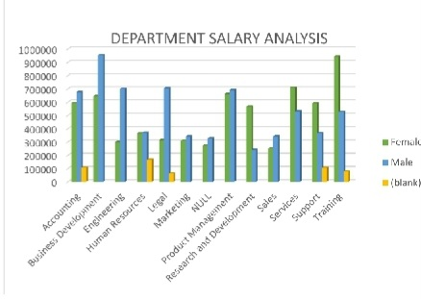
RESULTS
12

Slide 13

conclusion
Our salary analysis has highlighted key disparities and provided actionable insights for creating a more equitable and competitive compensation structure. By implementing the recommended adjustments, the company can enhance employee satisfaction, improve retention, and align salaries with industry standards, ultimately supporting sustainable growth and a fair workplace.

